Slide 1


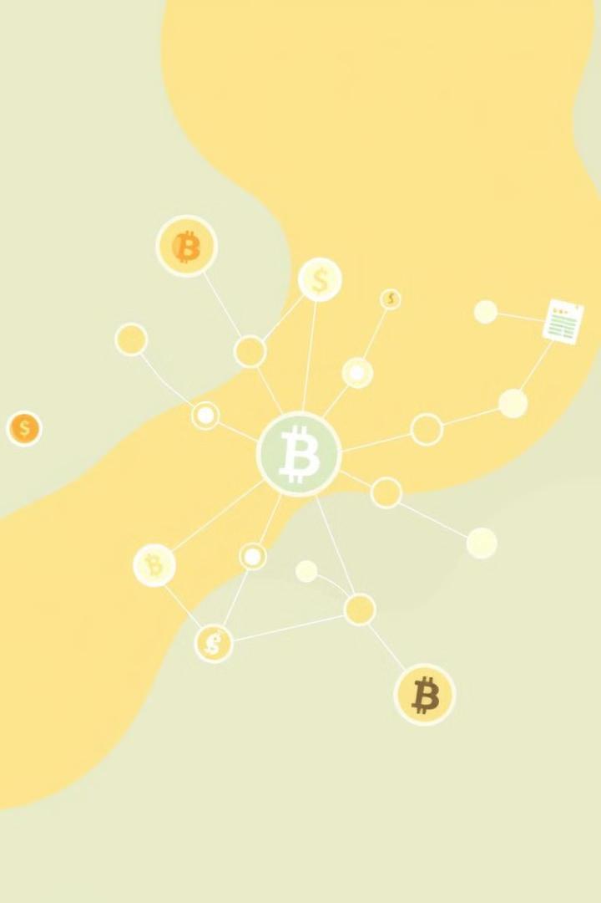
MAJOR PROJECT ON Identification of Counterfeit Products Using Blockchain Technology
Department of Information Technology
By Group(09)
T. Ruchitha : 21671A1254
P. Saiteja : 22675A1205
S. Vigneshwar : 21671A1245
Under the Guidance: Dr. G. Kumar
Assistant professor
Information Technology

Slide 2
List of Contents
Problem Statement
Abstract
Existing System
Advantages and Disadvantages (Existing System)
Proposed System
Advantages and Disadvantages (Proposed System)
Software Requirements
Hardware Requirements
Modules
System Architecture
UML Diagrams
Steps
SHA-256 Algorithm
Results
Conclusion
References

Slide 3
Problem Statement
Most of the Consumers purchase from remote locations, there is a risk of receiving fake products. This bogus products harms both the client and company’s reputation. Before dealing with this problem, there is no correct solution. Blockchain is the promising developing technology for this issue.
The problems in the society are as follows:
Fake products : The market is flooded with fake products, leading to financial losses and reputational damage for brands.
Inefficient Verification : Current methods for verifying product authenticity are prone to manipulation and error, making them unreliable.
High Cost of Fraud Prevention : Traditional fraud detection and prevention measures such as Holograms, Barcodes, RFID Tags, Third Party Authentication especially for luxury goods are costly and often fail to fully eliminate the risk of fake products.

Slide 4
Abstract
Blockchain is an innovative technology that might change computing in the future and offer more innovative solutions across several sectors. The emergence of cryptocurrencies has increased its appeal. Blockchain Technology is proposed as a solution to prevent counterfeit products.
A decentralized system allows customers to verify product authenticity without relying on intermediaries. Blockchain ensures product verification is accurate and tamper-proof.

Slide 5
Existing System
Over the years, there’s been increased adoption of cloud based SCM(Supply chain management). According to the researchers, the structure of cloud storage is central.
The use of a frequency identification tag in the detection of counterfeit goods. RFID(Radio frequency identification tags) collects and stores data using low-frequency radio waves.

Slide 6
Advantages And Disadvantages of Existing System
Advantages:
Cloud based SCM systems are more scalable and efficient.
RFID tags eliminates the need for physical inspection of verification process.
RFID tags can store product information such as manufacturing date, batch number and other relevant details.
Disadvantages:
As cloud based systems are centralized, it needs intermediaries and the authenticity of the product may not be verified.
Implementing an RFID system can be expensive, especially for small and medium-sized businesses due to the cost of tags, readers and infrastructure.

Slide 7
Proposed System
Decentralized network:
We propose a decentralized blockchain based system, that is Dapp(Decentralized Application) which is useful for product authentication that utilizes smart contracts to automate the verification process.
Working :
This System would allow manufacturers to register their products on the blockchain and generate a unique digital identity for each item. Consumers would able to scan the product’s digital identity, allowing the consumer to know about the product’s authenticity.
Transparency :
The blockchain technology provides a transparent and auditable record to all transactions in the network.

Slide 8
Advantages And Disadvantages
Advantages:
Immutability: Once data is recorded on the blockchain, it cannot be altered, ensuring the authenticity of product information.
Transparency: The entire supply system is visible to all authorized parties, increasing trust in the product’s origin and quality.
Brand Protection: Strong brand reputation can be maintained by preventing counterfeit products entering the market.
Disadvantages :
Scalability: Blockchain systems can become slow and inefficient as the number of transactions increases.
Implementing and maintaining a blockchain system can be complex.

Slide 9
Software Requirements
Operating Systems : Windows 7 or above
Coding Language : Solidity, Python, Html, CSS
IDE’s : Python IDLE
Tools : Truffle, Notepad++

Slide 10
Hardware Requirements
Hard disk : 20GB
RAM : 4GB and above
Processor : i3 and above
Key Board : Standard Windows Keyboard

Slide 11
Modules
Admin Module :
Admin can login to application by using username and password.
Add Product Details :
Using this module admin will enter product details and then upload QR image and then system will generate digital signature from QR image and then store all those details in Blockchain.
View Product Details:
Using this module admin can see all product details uploaded.
View User Details:
Admin can see all registered user details.

Slide 12
Modules
User Signup:
Using this module user can signup with the application.
User Login:
Using this module user can login to application
Retrieve Product Data:
Using this module user can enter product id and then details will be retrieve from Blockchain
Authenticate Scan:
Using this module user can upload Barcode image and then this image will get authenticate from Blockchain based on Digital signatures and if Barcode is not tampered then it will get authenticated and product details will be retrieve.

Slide 13
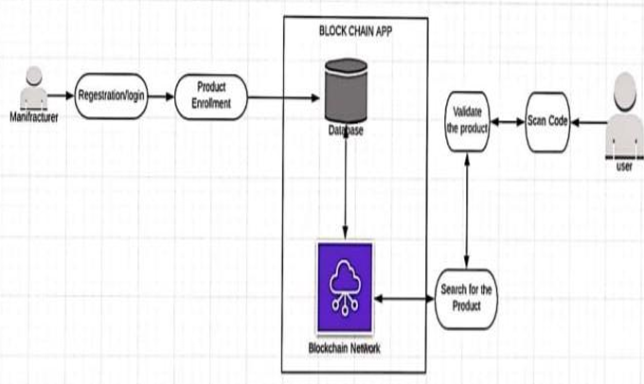
System Architecture

Slide 14
UML Diagrams

Slide 15
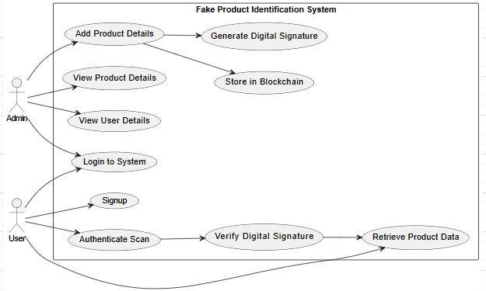
Use Case Diagram
The Use case diagram shows the interaction between the User and Manufacturer with the Blockchain App for processes such as product registration, enrollment, scanning, searching, and validation. It emphasizes the flow of data through the database and blockchain network to ensure product authenticity and secure recordkeeping.

Slide 16
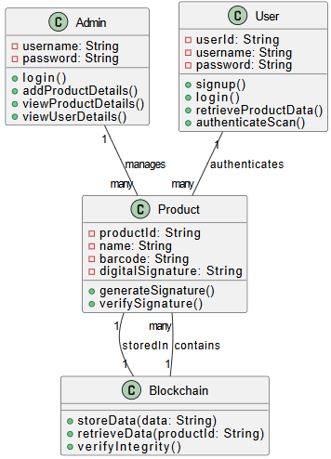
Class Diagram
The Class diagram illustrates the relationships between key entities such as the Manufacturer, User, Product, Blockchain App, Database, and Blockchain Network. It defines their attributes and methods, showing how product data is created, stored, retrieved, and validated within a secure blockchain-based system.

Slide 17
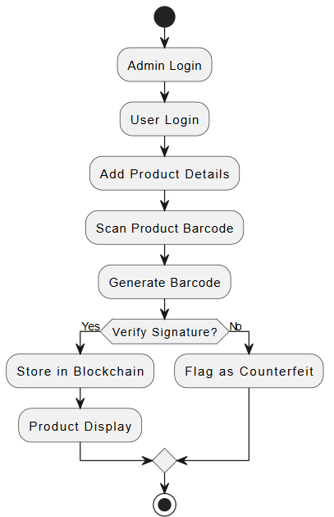
Activity Diagram
Activity diagram represents a blockchain-based product authentication system. It begins with admin and user logins, followed by adding product details and scanning barcodes. A barcode is generated, and the product’s signature is verified. If valid, the data is stored in the blockchain and displayed; otherwise, it's flagged as counterfeit.

Slide 18
SHA-256 Algorithm
SHA-256 (Secure Hash Algorithm 256-bit) is a cryptographic hash function that belongs to the SHA-2 family, designed by the National Security Agency (NSA) and published by the National Institute of Standards and Technology (NIST). It is widely used for data integrity verification, digital signatures, and blockchain technology.
Fixed-Length Output: Always produces a 256-bit hash regardless of input size.
Deterministic: The same input will always produce the same hash.
Collision Resistant: It is computationally infeasible to find two different inputs with the same hash.
Irreversible: The original input cannot be derived from the hash.
Avalanche Effect: A small change in input causes a completely different hash.

Slide 19
Steps
Step-1 : Login/Signup
if user is manufacturer then registers product and generate
digital signature for QR Code.
2. Step-2 : if user is consumer
Login/ Signup and uploads the QR Code and verifies the
authentication of the product.

Slide 20
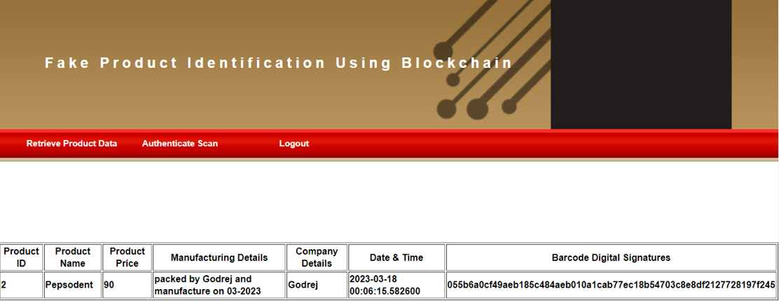
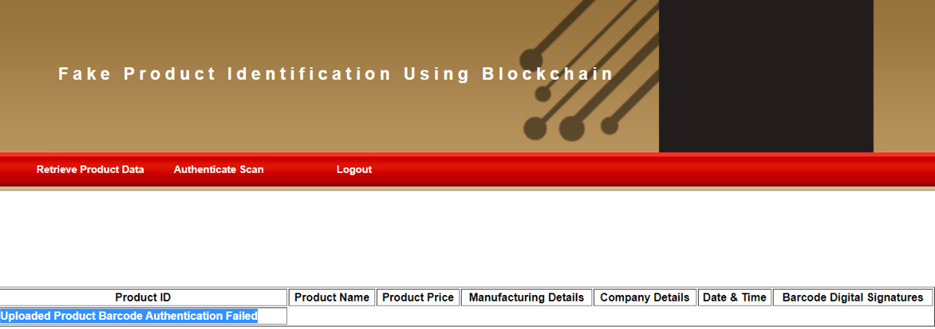
Results

Slide 21

Conclusion
In conclusion, this project successfully demonstrates the potential of a decentralized and secure system for tracking product authenticity.
Thus, this system ensures that customers can confidently verify the legitimacy of products.
The architecture simplifies the verification process, reduces the reliance on third parties, and enhances trust between manufacturer and consumer.

Slide 22
References
Da’u and N. Salim, “Sentiment-Aware Deep Recommender System With Neural Attention Networks,” in IEEE Access, vol. 7, pp. 45472 45484, 2019.
M. Xu and S. Liu, “Semantic-Enhanced and Context-Aware Hybrid Collaborative Filtering for Event Recommendation in Event- Based Social Networks,” in IEEE Access, vol. 7, pp. 17493-17502, 2019.
S. Paul, J. I. Joy, S. Sarker, A. -. A. -. H. Shakib, S. Ahmed and A.K. Das, “Fake News Detection in Social Media using Blockchain,” 2019 7th International Conference on Smart Computing & Communications (ICSCC), Sarawak, Malaysia, 2019, pp. 1-5.
Li ST, Pham TT and Chuang HC, “Do reviewers words affect predicting their helpfulness ratings? Locating helpful reviewers by linguistics styles”, Information and Management, vol. 56, pp. 28-38, 2019.
S. Chen, R. Shi, Z. Ren, J. Yan, Y. Shi and J. Zhang, “A Blockchain Based Supply Chain Quality Management Framework,” 2017 IEEE14th International Conference on e-Business Engineering (ICEBE), Shanghai, China, 2017, pp. 172-176.
Khalil, Ghaith, Robin Doss, and Morshed Chowdhury, “A Comparison Survey Study on RFID Based Anti-Counterfeiting Systems,” Journal of Sensor and Actuator Networks, Switzerland, vol.8, pp. 37, 2019.

Slide 23
THANK YOU

